Slide 1


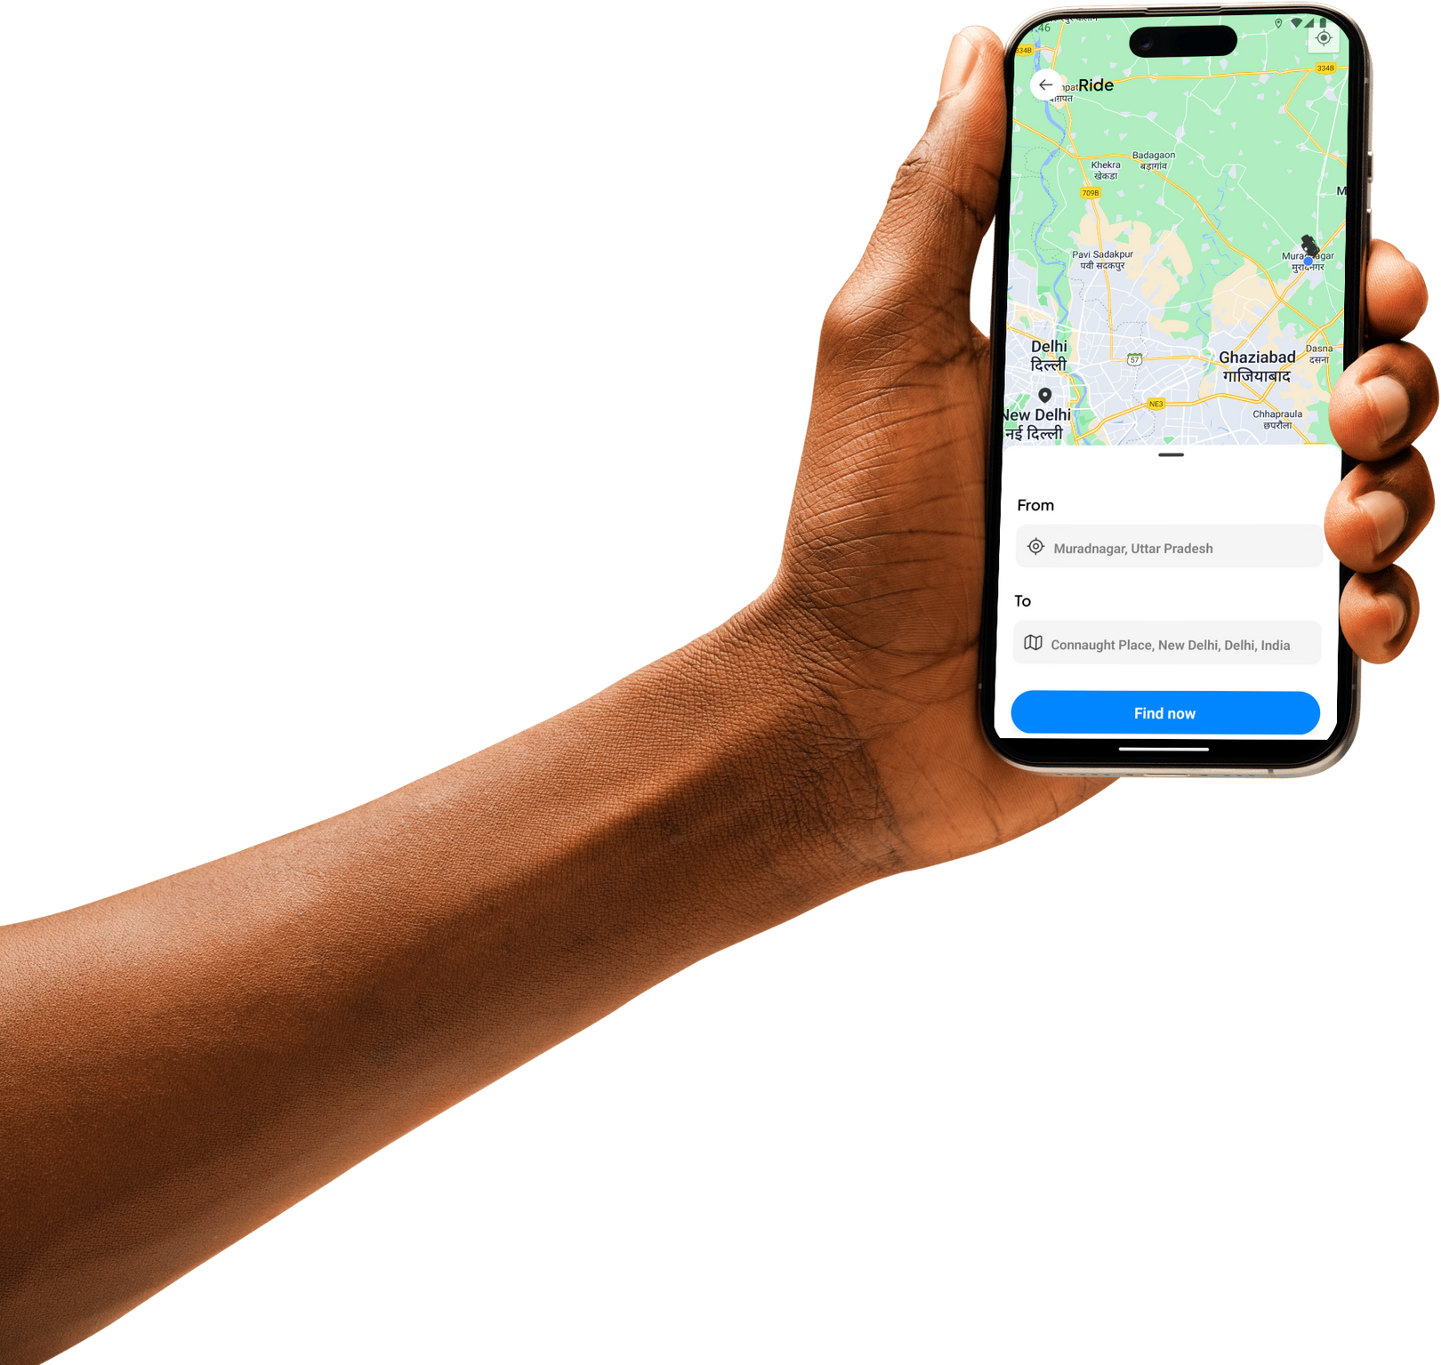

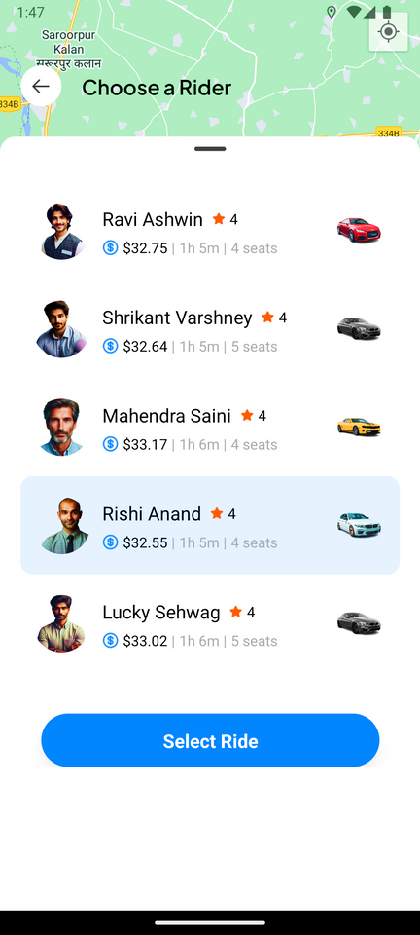
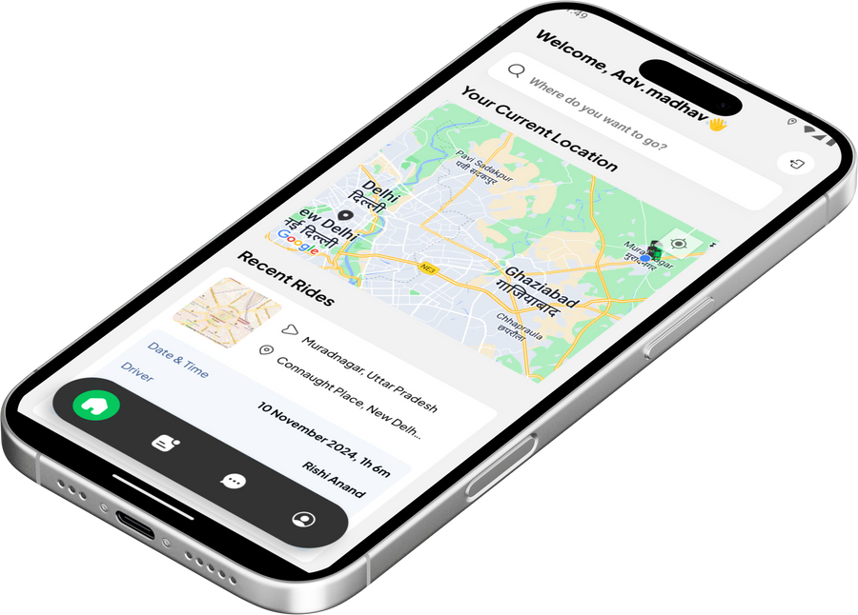

Slide 2

Mini Project (KCA353)
Odd Semester
Session 2024-25
GB09: ChaloRidePe
Meenakshi Bharadwaj 2300290140102
Murari Kumar Jha 2300290140105
Nikhil Chaudhary 2300290140107
Pawan Gangwar 2300290140113
Project Supervisor:
Ms. Monika Kansal
Assistant Professor

Slide 3

Project Abstract
Today's urban settings demand dependable and effective transportation. As the need for smooth travel options in crowded places grows, ChaloRidePe shows up as a vibrant and easy-to-use ride-hailing service. Whether you're traveling to work, attending an important meeting, or exploring new areas of the city, it enables passengers to communicate in real-time with local drivers, guaranteeing a seamless and stress-free journey. ChaloRidePe offers real-time transportation scheduling, precise fare predictions, and safe cashless payment processing. It provides a smooth and safe experience because of its user-friendly interface, which is improved with safety measures and robust validations to guarantee legitimate users. Without the hassles of conventional transportation alternatives, users may easily book trips and complete transactions. ChaloRidePe is a useful tool for traversing today's hectic cities because of its emphasis on client comfort, safety, and efficiency. It offers a dependable, easily available alternative to urban commuting, perfect for both impromptu travel and routine commutes.

Slide 4
Project Objectives and Goals
The primary goal of ChaloRidePe is to cater its audience, including customers
Convenience: Easy to use and understand
Affordability: To provide affordable rides to users
Accessibility to all users
Safety: Legitimate Users
Reliability: Available whenever user require and reliable to them.

Slide 5


Alignment with UN Sustainable Development Goals (SDGs)
SDG 8: Decent Work and Economic Growth
The app creates economic opportunities for local drivers, enabling them to earn income through flexible work. It also promotes local economic activity by making travel and commuting more accessible and efficient.
SDG 9: Industry, Innovation, and Infrastructure
ChaloRidePe leverages technology to improve transportation infrastructure, addressing urban mobility issues through innovative, tech-driven solutions. By enhancing transportation efficiency, it contributes to more sustainable and resilient urban infrastructure.

Slide 6








Technology (Hardware and Software Requirements)
Hardware Requirements
Processor: Intel(R) Core(TM) i5-9300H CPU @ 2.40 GHz
RAM: 8.00 GB
System Type: 64-bit operating system, x64-based processor
Storage Required: Maximum Up to 16 GB
Software Requirements
Operating System: Windows 11, Version 23H2
Code Editor: Visual Studio Code, v1.93.1
Frontend: React Native Expo, Typescript, Tailwind CSS
Backend: Neon DB, PostgreSQL
Authentication: Clerk Auth
APIs: Here Maps Geocoding and Search API; Here Maps Routing API
Payment Integration: Stripe Method

Slide 7
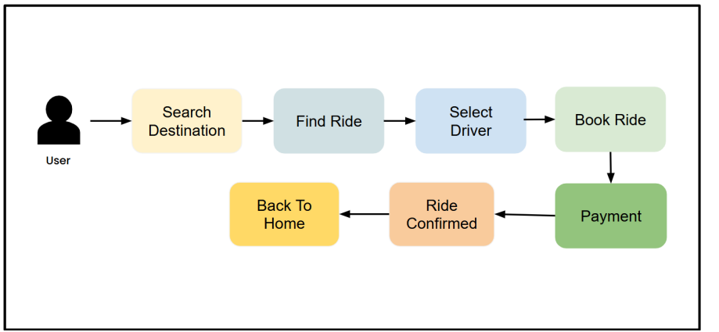
Workflow

Slide 8
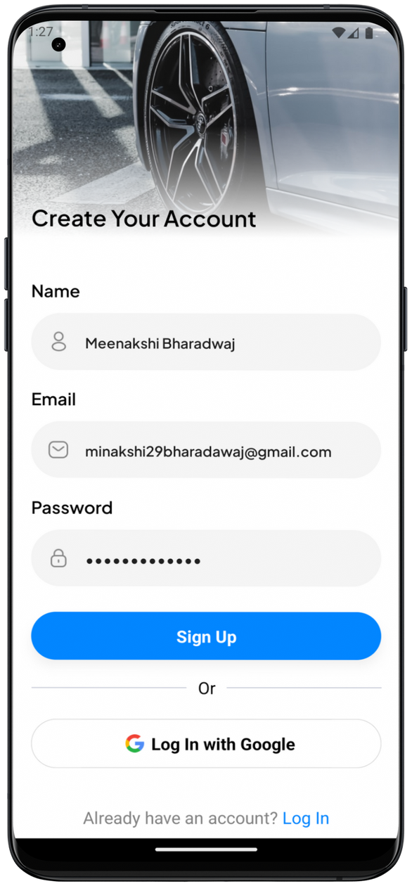
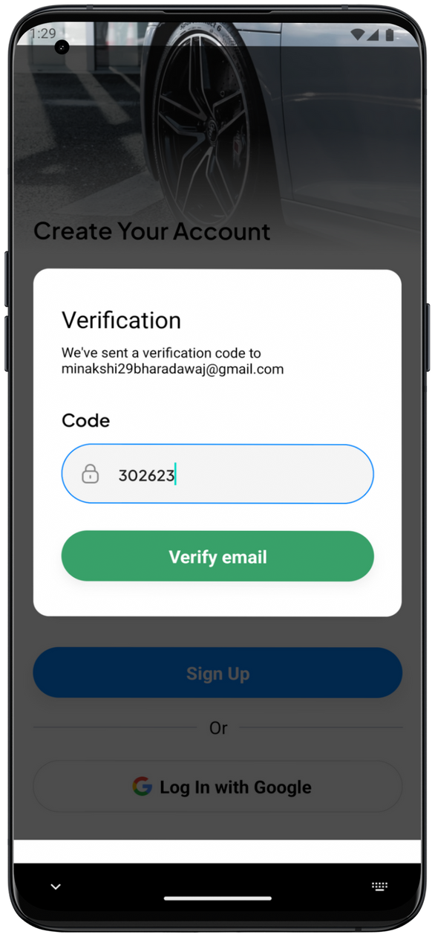
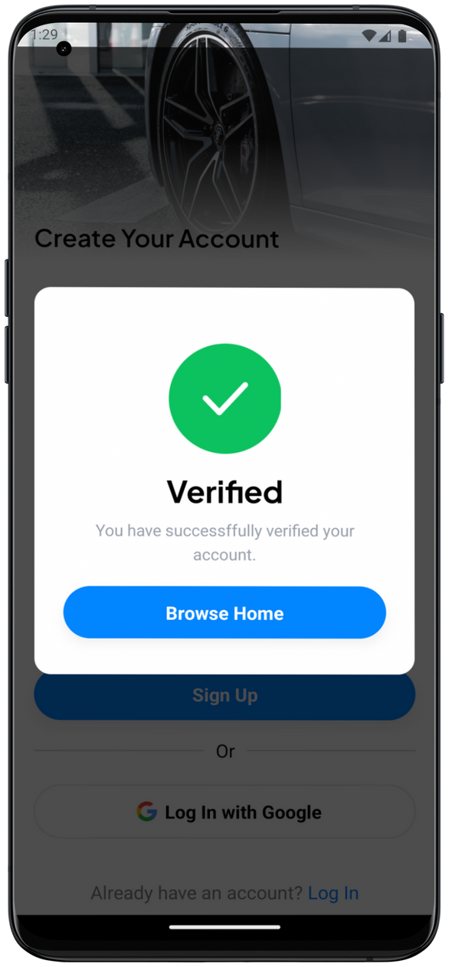
Methodology and Approach
Module 1: Authentication
User Sign up using email and password
User Log in
User Sign in using Google Accounts
Services such as Clerk Email Auth, OAuth

Slide 9
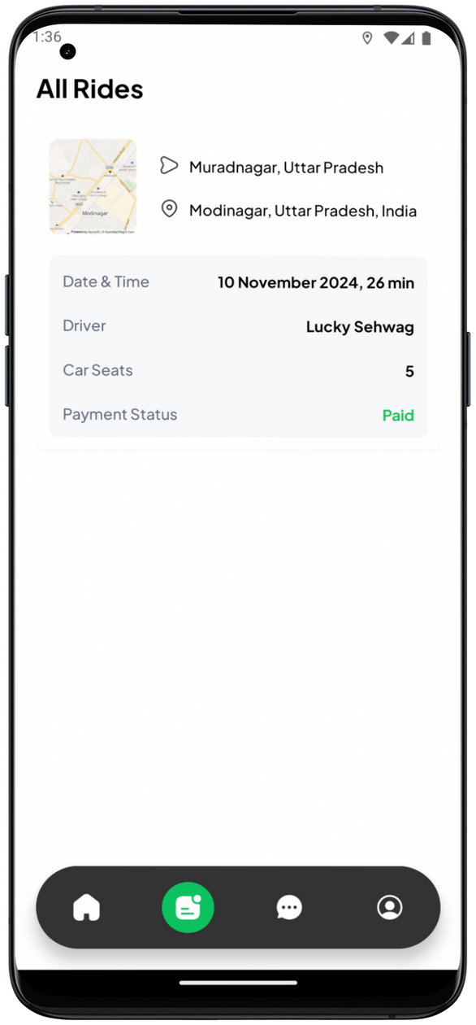

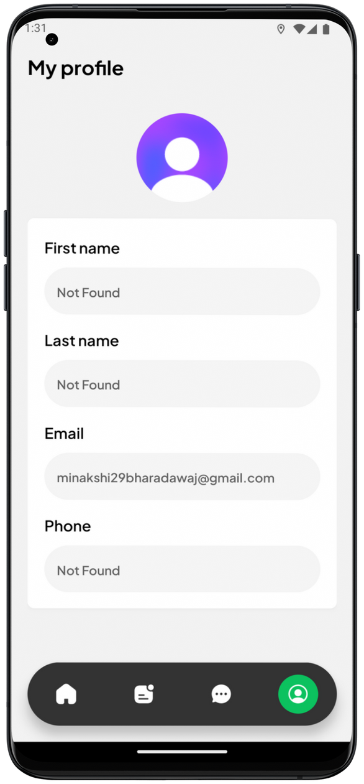
Methodology and Approach
Module 2: User Profile
User information
Profile picture, first name, last name,
email, phone number
Ride history
Chats

Slide 10
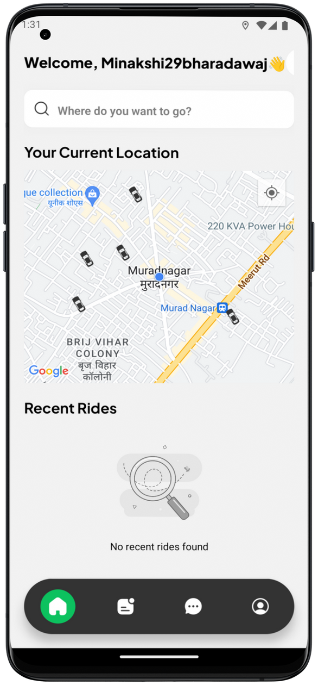
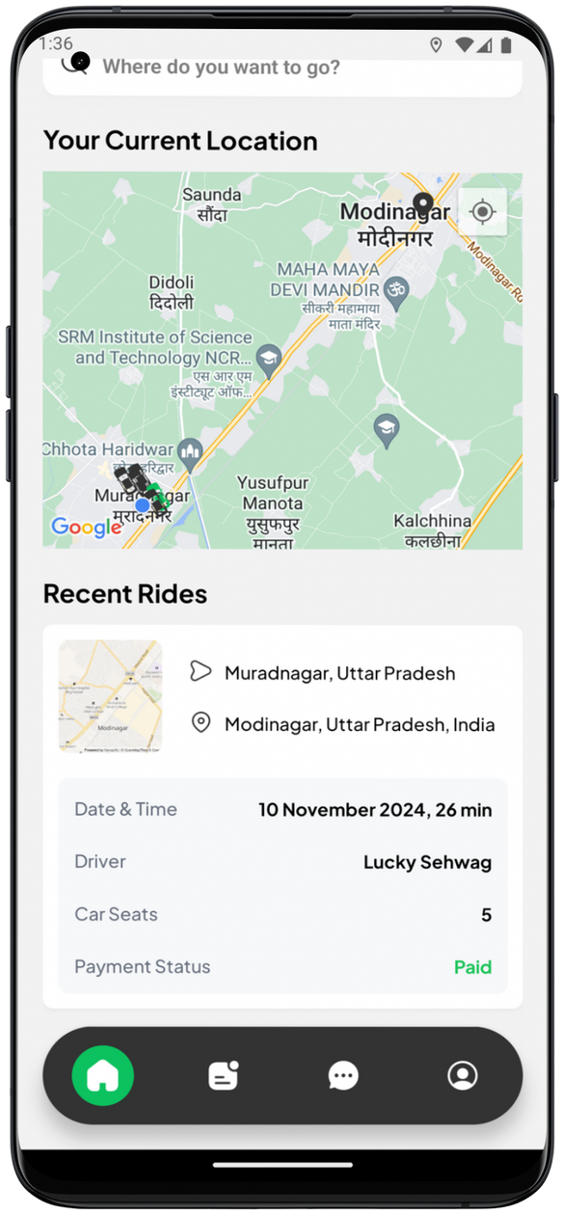
Methodology and Approach
Module 3: Map and Location Services
Integration with a mapping API (Here Maps API)
Real-time location tracking
Geocoding and reverse geocoding

Slide 11
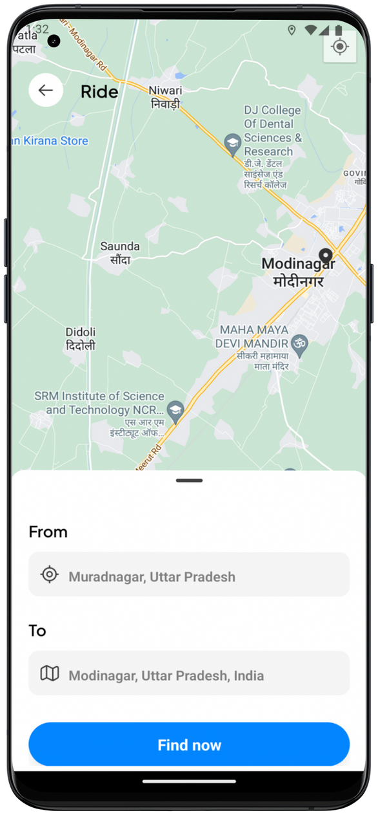
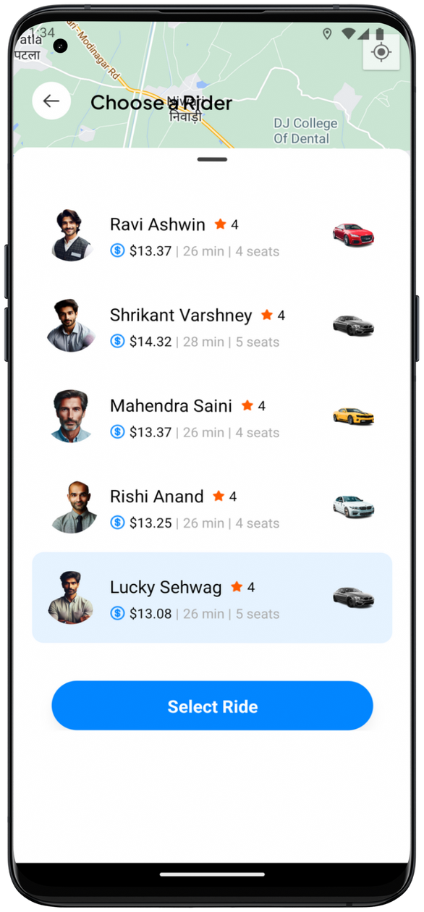
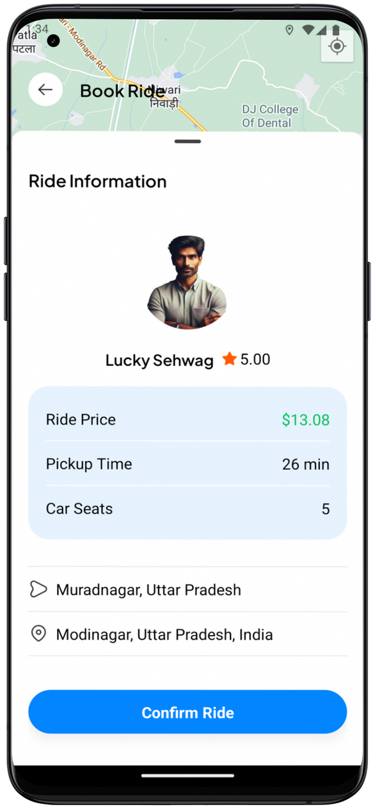
Methodology and Approach
Module 4: Find and Confirm Ride
Find rides
Driver Selection
Confirm Ride

Slide 12
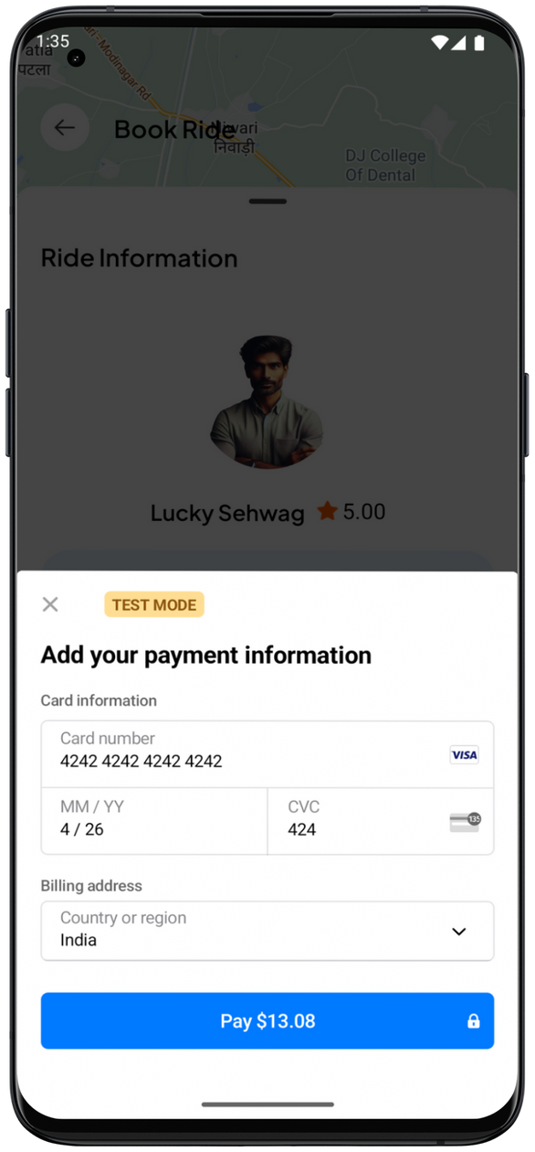
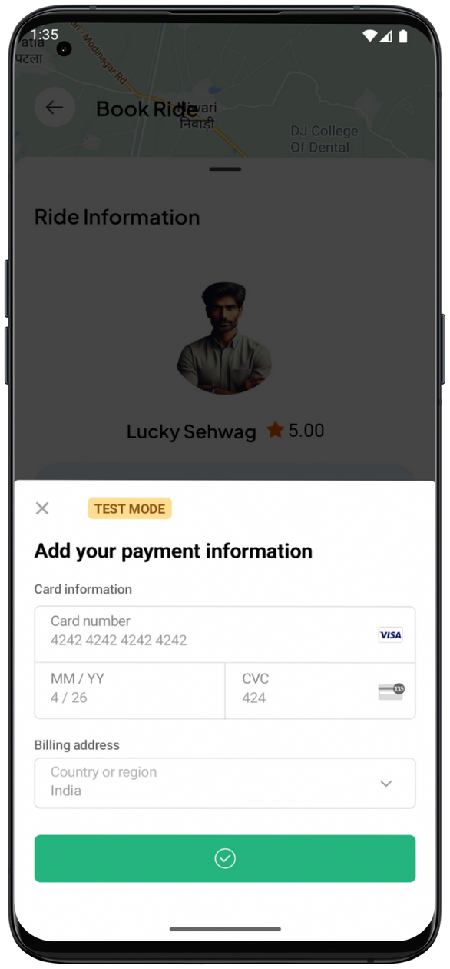
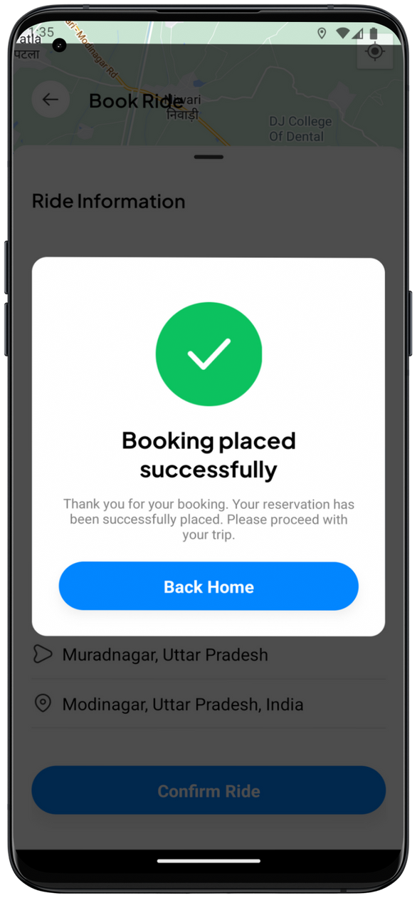
Methodology and Approach
Module 5: Payments
Payment Integration using services such as Stripe
Payment methods such as card
Payment confirmation

Slide 13
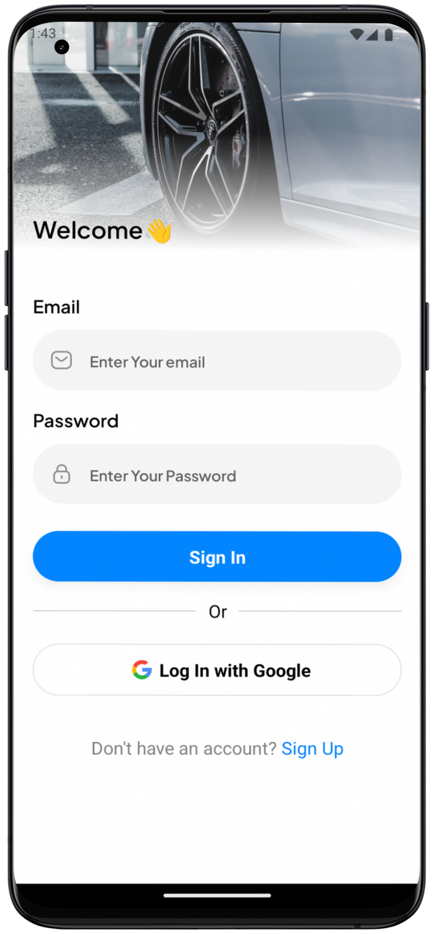
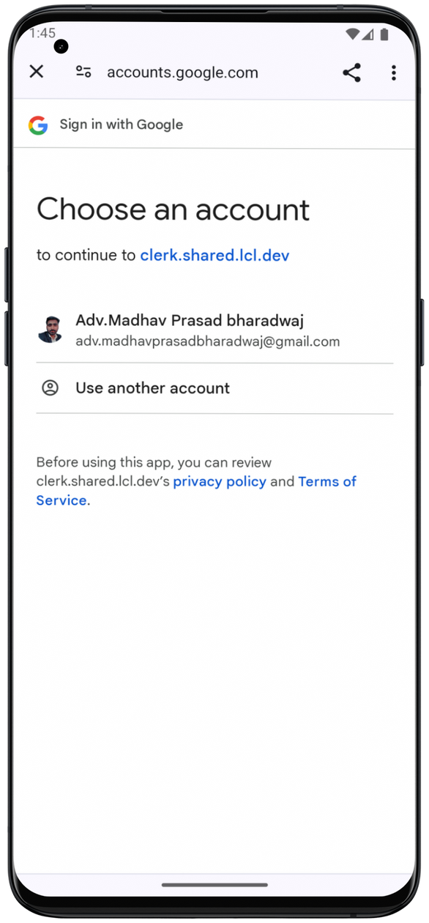
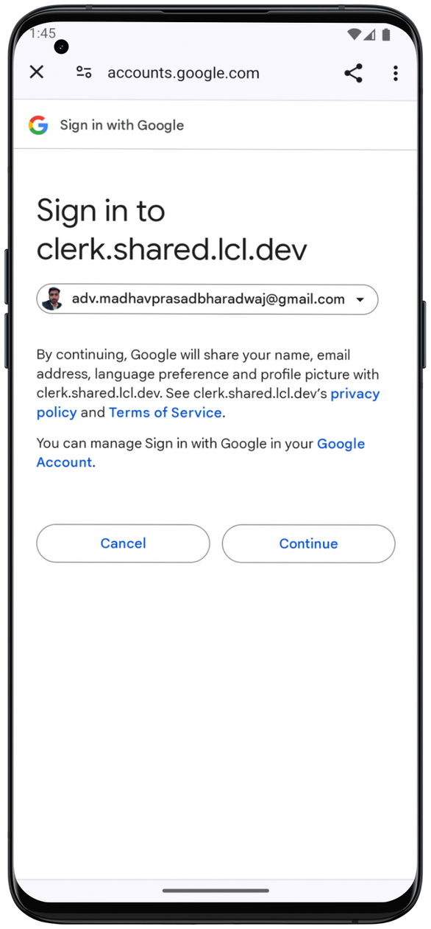
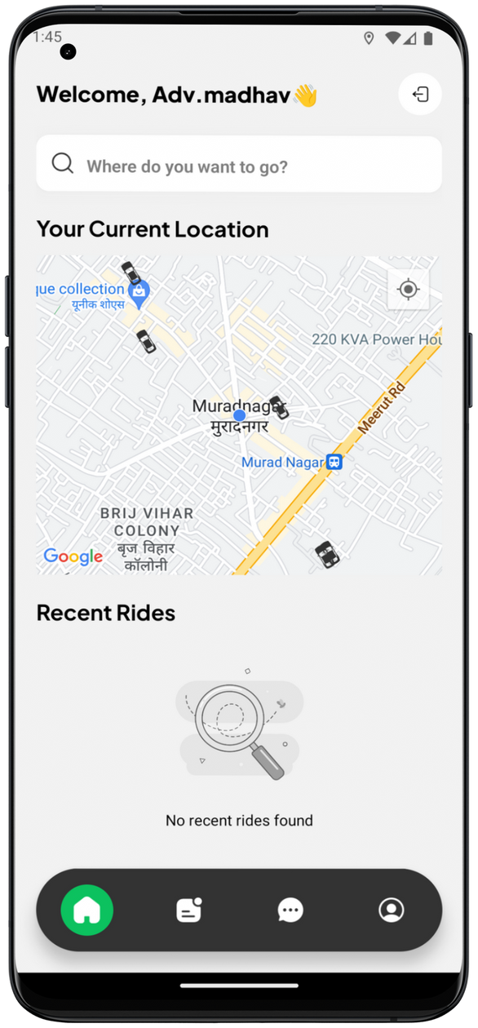
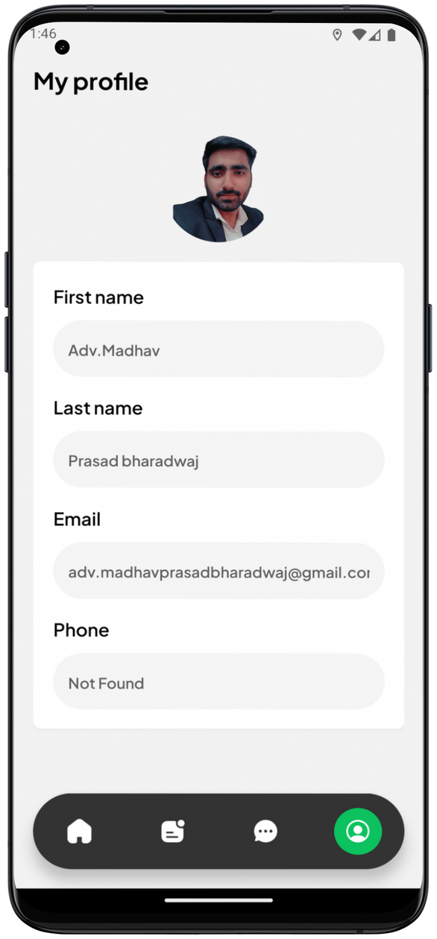
Google OAuth Authentication

Slide 14
Project Outcomes
Convenience and Accessibility Flexibility
Safety with Legitimate App users

Slide 15
References
React Native Documentation. [https://reactnative.dev/]
Clerk Authentication Services. [https://clerk.dev/]
Here Maps API Documentation. [https://developer.here.com/]
Stripe Payment Integration. [https://stripe.com/docs/]
Neon Database Documentation. [https://neon.tech/]

Slide 16
Thank You!

